Slide 1


Slide 2
Introduction
I’m Amudha, a Data Analyst based in Singapore.
This presentation explores customer profitability and the impact of shipping costs on gross margins.
Using Power BI, I’ve developed interactive visuals and key metrics to uncover actionable business insights.
The goal is to support data-driven decision-making and highlight opportunities for operational efficiency.

Slide 3
General Process
Introduction
Problem Statement
Research Objective
Methodology / Proposed Solution
Data Understanding and Preparation
Data Pre-processing
Analysis and Report Creation
Results
Conclusion

Slide 4
General Process
📘 Introduction:
The rapid growth of e-commerce has transformed how businesses interact with customers, manage inventory, and drive revenue. In this competitive landscape, data-driven decision-making is essential for optimizing operations and enhancing customer experience. This report leverages business intelligence tools to analyze customer demographics and purchasing behavior using integrated datasets customers and purchase data. The goal is to uncover actionable insights that support strategic planning, targeted marketing, and operational efficiency.

Slide 5

General Process
Problem Statement:
E-commerce companies collect vast amounts of customer and purchase data, yet this information
often remains underutilized. Without structured analysis, businesses encounter several challenges:
Limited visibility into customer demographics, segmentation, and behavioral patterns.
Difficulty in tracking sales performance across products, categories, and regions.
Inability to identify high-value customers and measure their contribution to overall
revenue.
Lack of clear KPI monitoring for revenue growth, repeat purchases, and customer lifetime
value.

Slide 6
General Process
Problem Statement:
These challenges raise critical business questions, such as:
Which customers generate the highest revenue?
Which products are the most profitable?
How do shipping costs affect overall margins?
As a result, organizations risk missing valuable opportunities to improve customer retention, enhance marketing efficiency, and drive sustainable business growth.

Slide 7

General Process
Research Objective :
This project aims to transform raw e-commerce datasets into actionable insights by:
Profiling customers by demographics, geography, and income levels.
Identifying high-value customers and analyzing their contribution to revenue.
Evaluating sales performance across products, categories, and regions.
Measuring the impact of shipping costs on profit margins.
Monitoring key business metrics such as revenue growth, average order value,
and customer retention.

Slide 8

General Process
Proposed Solution :
To address these challenges, customer and purchase datasets are integrated into an interactive Power BI dashboard. The solution includes:
Data Preparation & Modeling: Cleaning and connecting customer and purchase data for
analysis.
Visual Analytics: Designing dashboards that highlight revenue trends, customer segmentation,
and product profitability.
KPI Tracking: Monitoring metrics such as total revenue, repeat purchases, average customer
age, and income levels.
Profitability Analysis: Examining the relationship between shipping costs and margins to
optimize pricing and logistics strategies.
This approach enables decision-makers to move from raw data to strategic insights, supporting data-driven decisions that improve profitability, customer engagement, and long-term business growth.

Slide 9

General Process
Data Understanding and Preparation :
This step involves reviewing and refining the raw data to ensure it's ready for analysis. We start by exploring the structure of both datasets— customer and purchase —to understand what information they contain. Next, we clean the data by removing duplicates, handling missing values, and standardizing formats. Then, we transform key fields (like calculating total purchase amount or grouping ages into buckets) and build relationships between tables using common identifiers like Customer ID. This process ensures the data is accurate, consistent, and structured for meaningful insights in Power BI.

Slide 10
General Process
Data Pre-processing :
Performed preprocessing to ensure data quality and consistency for analysis and visualization.
Cleaned customer.csv and purchase.csv
Standardized data types (dates in proper format, monetary values with “$”).
Added additional columns to support visualizations.

Slide 11

General Process
Analysis and Report Creation:
Using Power BI, we designed an interactive dashboard that visualizes key metrics such as total sales, customer segmentation, product performance, and geographic trends. The report integrates data from both customer.csv and purchase.csv, enabling dynamic filtering and drill-down capabilities. Visuals were selected to support business decision-making, with slicers and tooltips enhancing user experience and analytical depth.

Slide 12

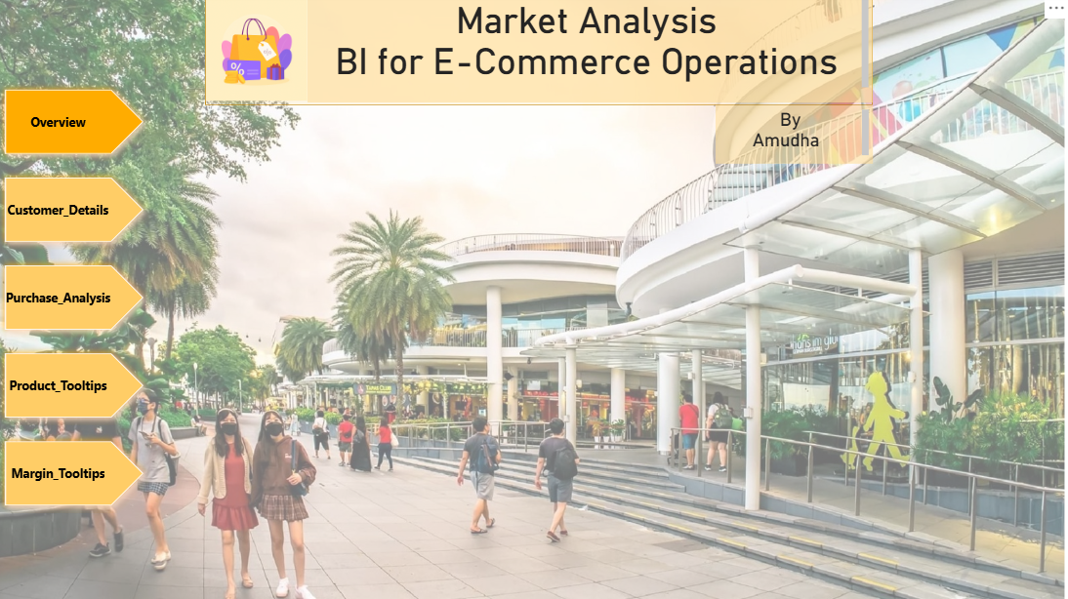
Results: Key KPIs for the E-Commerce Dashboard:
🔷 Title: E-commerce Analytics – Overview

Slide 13
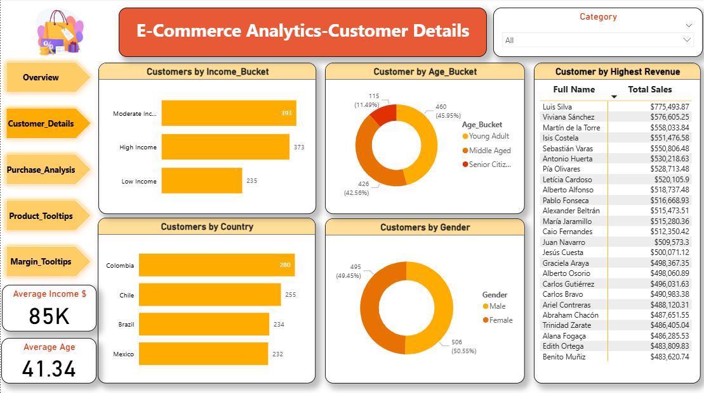
Results: Key KPIs for the E-Commerce Dashboard:
🔷 Title: E-commerce Analytics – Customer Details

Slide 14
Key KPIs for the E-Commerce Dashboard:
🔷 Customer Details
Customers by Income Bucket (Stacked bar chart) –
Customers are segmented into Low Income, Moderate Income, and High Income,
to analyze purchasing behavior across different income levels.
Customers by Country (Stacked bar chart) –
Customers are segmented into Colombia, Chile, Brazil, and Mexico to analyze
purchasing behavior across different countries.
Customers by Age Bucket (Donut Chart) –
Customers are segmented into age buckets — Young Adult, Middle Aged, and
Senior citizen— to analyze purchasing behavior across different age groups.
Customers by Gender (Donut Chart) - Customers are segmented by gender —
Male and Female — to analyze purchasing behavior across different groups.

Slide 15
Key KPIs for the E-Commerce Dashboard:
🔷 Customer Details
Category: Enable users to select a product dynamically based on its associated
category and display the corresponding product details.
Average Age (Card): Average Customer Age
Average Income $ (Card): Average Customer Income
Customer by Highest Revenue (Matrix): Lists each customer’s name with their
total sales to show who contributes the most.

Slide 16
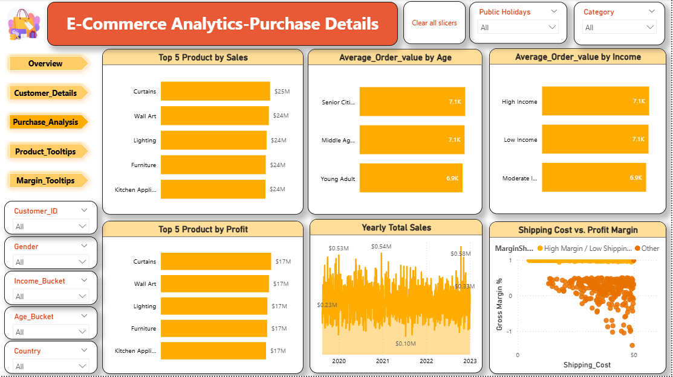
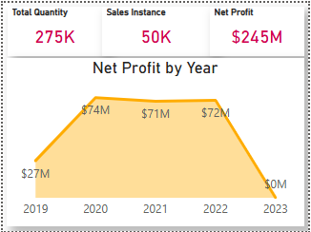

Results: Key KPIs for the E-Commerce Dashboard:
🔷 Title: E-commerce Analytics – Purchase Details
Product Tooltips
Margin Tooltips

Slide 17
Key KPIs for the E-Commerce Dashboard:
🔷 Purchase Details
Top 5 Products by Sales (Stacked bar chart):
Displays the five products with the highest total sales, helping identify which
items are driving the most revenue.
Top 5 Products by Profit (Stacked bar chart):
Displays the five products with the highest total profit, helping identify which
items are driving the most revenue.
Average Order value by Age (Stacked bar chart):
Displays the average order amount for young adult, middle-aged, and senior citizen
customers to highlight spending patterns across age groups.

Slide 18
Key KPIs for the E-Commerce Dashboard:
🔷 Purchase Details
Average Order value by Income (Stacked bar chart):
This chart shows how much customers spend on average, grouped by income level—
High, Moderate, and Low. It helps compare spending habits across different income
groups.
Yearly Total Sales (Area Chart):
This area chart illustrates the total sales amount aggregated annually, offering a clear view of
year-over-year performance and enabling the identification of long-term sales trends.
Shipping Cost Vs Profit Margin (Scatter chart):
Analyze the relationship between shipping cost and gross margin across purchases to
identify high-performing and low-efficiency transactions.

Slide 19
Key KPIs for the E-Commerce Dashboard:
🔷 Purchase Details
Customer ID (Slicer):
Enables users to filter the report by specific customer IDs.
Gender (Slicer):
Allows users to filter data based on customer gender, enabling targeted analysis
and comparison across male and female segments.
Income Bucket (Slicer):
Enables users to filter data by customer income levels—such as Low, Moderate, and High Income—
to support targeted analysis and comparison across financial segments.
Age Bucket (Slicer):
Allows users to filter data by age group—such as Young Adults, Middle-Aged, and Senior Citizens—
to support demographic analysis and comparison across customer segments.

Slide 20
Key KPIs for the E-Commerce Dashboard:
🔷 Purchase Details
Country (Slicer):
Allows users to filter data by country, enabling geographic analysis and comparison across regional
markets or customer locations.
Public Holidays:
This functionality allows users to select a specific public holiday from the slicer, upon which the
dashboard will display the corresponding details related to that holiday.
Category: Enable users to select a product dynamically based on its associated category and display
the corresponding product details.
Clear All Slicers (Button):
Resets all slicer selections to their default state, allowing users to view the full dataset without
any applied filters. (Insert -> Buttons-> Clear All Slicers)

Slide 21
Key KPIs for the E-Commerce Dashboard:
🔷 Product Tooltips:
Total Quantity (Card):
Represents the aggregated quantity of items sold or ordered, calculated using the SUM function
on the Quantity field.
Sales Instance (Card):
Represents the total number of individual sales transactions, calculated by counting the unique
Order IDs in the dataset.
Net Profit (Card):
Represents the total profit earned after deducting all expenses, calculated using the SUM of the
Net Profit field.
Net Profit by Year (Area Chart):
This visualization displays the total net profit aggregated by calendar year, enabling clear analysis
of financial performance trends over time

Slide 22
Key KPIs for the E-Commerce Dashboard:
🔷 Margin Tooltips:
• Product Name (Card):
Displays the name of the selected product, based on user interaction or slicer selection.
• Total Revenue (Card):
Shows the total revenue generated by the selected product, calculated from sales data.
• Gross Margin % (Card):
Indicates the gross margin percentage for the selected product, reflecting its
profitability after deducting shipping costs.

Slide 23

General Process
Conclusion:
Preprocessing, analysis, and visualization of customer.csv and purchase.csv provided valuable insights into customer behavior and sales performance.
Ensured data accuracy and applied appropriate data types.
Created meaningful visualizations to highlight key trends:
Identification of high-value customers.
Recognition of peak sales periods.
Discovery of top-performing products.
Insights can guide data-driven strategies to:
Improve customer engagement.
Optimize product offerings.
Enhance overall business growth.

Slide 24


